Slide 1

Bark of the 90’s
The 90’s called, they want their dog back.
Kodiak Shepard, Matthew Satterfield, & Rebecca Tester

Slide 2

High Concept Statement
A skater needs to rescue their dog from criminal Ella McDogH’tor by soaring through the sky and fighting 90’s-inspired enemies.

Slide 3
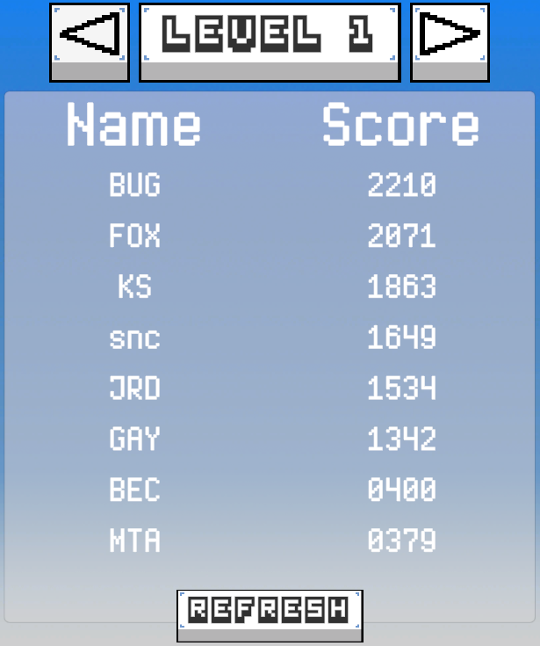

Final Features
Shooting Bullets
More Enemies
Highscores
Leaderboard
Notes:
Shooting: The player can now shoot the bullets
Enemies/Bosses: The bosses and enemies vary in each level in aesthetics and attacks
Highscores: Level scores are based on your health, points got in level, and speed. Player is encouraged to replay levels to get higher score.
Leaderboard also encourages replaying levels to get a higher score and compete with others.

Slide 4

Obstacles
Pixel art difficulties
Tutorial confusion
Spammable buttons
Notes:
Pixel art:
Tutorial: The tutorial was confusing for many playtesters. Players didn’t know what to do and were unaware of things like charged shots and dodging.
Spammable Buttons: Some buttons apart of the UI could be pressed rapidly and cause problems. The player could also spam the trick button.

Slide 5



Solutions
Practice makes perfect
UI explaining controls
Cooldowns
Notes:
Practice:
More Controls UI: To improve the tutorial and help players understand the controls, we added text next to the controls, had the controls appear at the beginning of each level, and added text indication of when you can use your charge shot.
Cooldowns: Cooldowns were added to the UI buttons and to the trick button to avoid misuse.

Slide 6
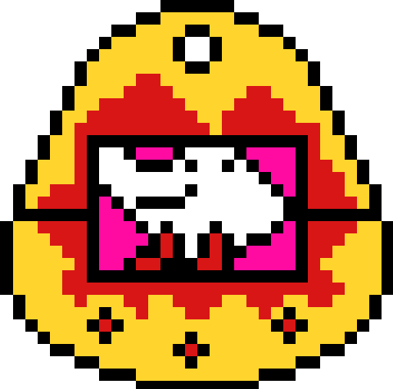
Fun Factor
Colorful Designs
Challenge & Competition
Dodging & Attacking
Optimizing for Highscores
Notes:
Bark of the 90’s has:

Slide 7


Core Mechanics
Moving
Dodging
Shooting

Slide 8

Gameplay
Genre: Shoot ‘em up, Rail Shooter, Bullet Hell
Controls:
WASD to move
Space to dodge, Ctrl to do a trick
Left click to shoot a standard bullet
Right click to shoot a charged shot
3 Levels + Tutorial

Slide 9

Gameplay (Continued)
Enemies will spawn and shoot bullets that will harm the player if they come in contact with them.
At the end of each level is a boss that the player must defeat to beat the level.

Slide 10
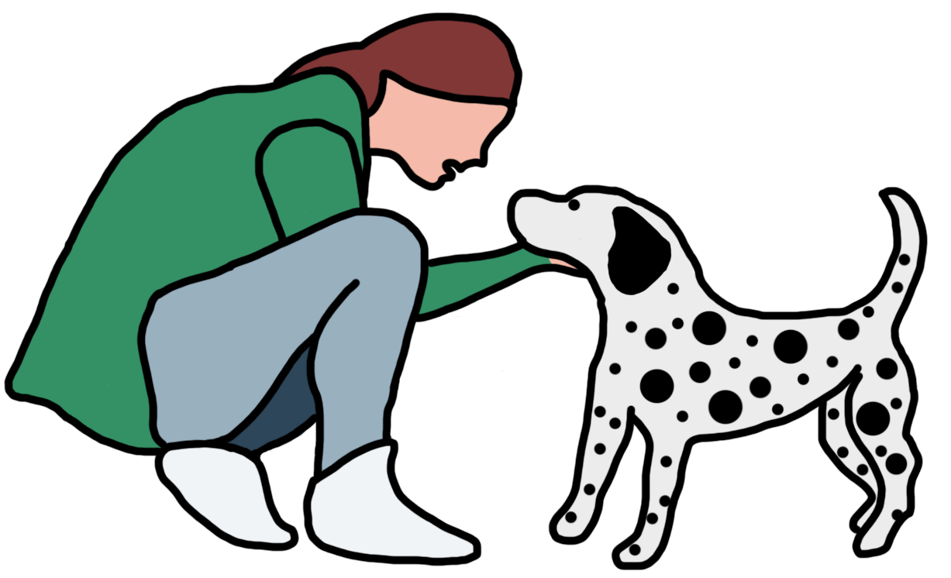
The player will be united with their dog upon beating the game.

